Slide 1
Predicting Malpractice Premiums: Analyzing the Impact of Hospital Costs and Other Predictors
Ismat Ara Khan
December 18,2024

Slide 2
Table of contents
Introduction
Exploratory Data Analysis
LASSO Model for selecting significant variables
Dataset Pre-processing
Building Models
Decision Tree
Random Forests
Neural Network
Conclusion

Slide 3
Introduction
Objective:
Evaluate the relationship between malpractice premiums and other hospital costs.
Methods:
Focus on EDA, then machine learning such as Decision Trees, and Random Forests, while also considering Neural Network.
Dataset:
Analysis of 2616 observations from USA Hospital Data collected in 2021.
Variables:
Dataset contains 74 variables, including a range of hospital and healthcare metrics, as well as socio-economic and patient data for each observation
Goal:
Identify key factors influencing malpractice premiums and how these properties contribute to overall assessment.

Slide 4
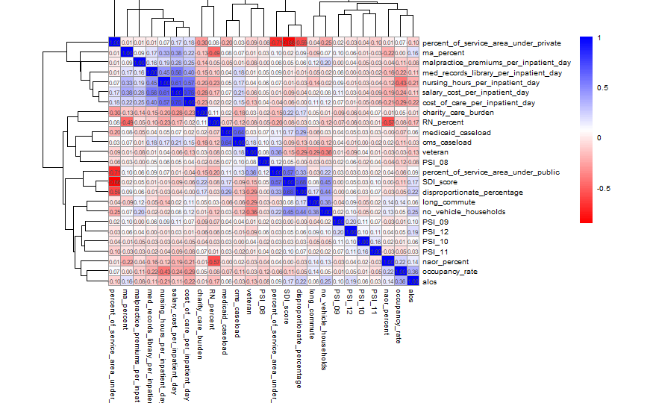
Exploratory Data Analysis – Data Visualization
From this Correlation Heatmap , we can conclude that, variables like (salary_cost_per_inpatient_day) and (nursing_hours_per_inpatient_day ) are positively correlated with higher malpractice premiums, while public service coverage (percent_of_service_area_under_public) shows a negative correlation.
Cost-related and operational scale variables are the strongest predictors of malpractice premiums.
Figure 3.1 Distribution of Physiochemical Properties

Slide 5
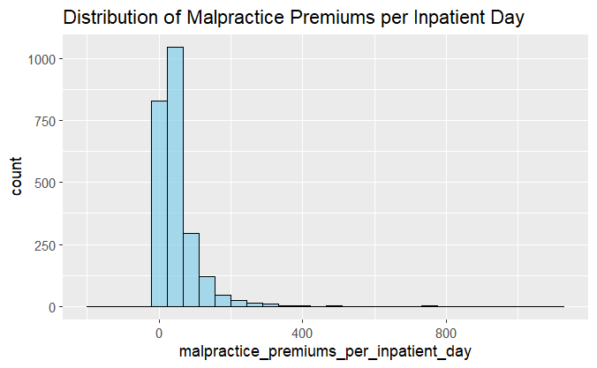
Exploratory Data Analysis – Data Visualization
From this Histogram, we can conclude that, since the data is highly skewed or follows a non-normal distribution, certain models (e.g., linear regression) may not perform well. Models that can handle skewed data, such as Decision Tree, Random Forest etc. has been chosen to predict.
Figure 3.1 Distribution of Physiochemical Properties

Slide 6
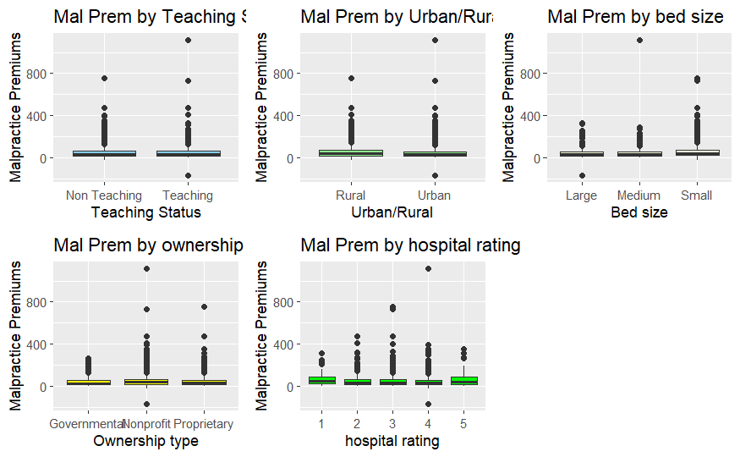
Exploratory Data Analysis – Data Visualization
These Box plots highlight variability in malpractice premiums, particularly among bed size categories and ownership types, with visible outliers in all cases.

Slide 7
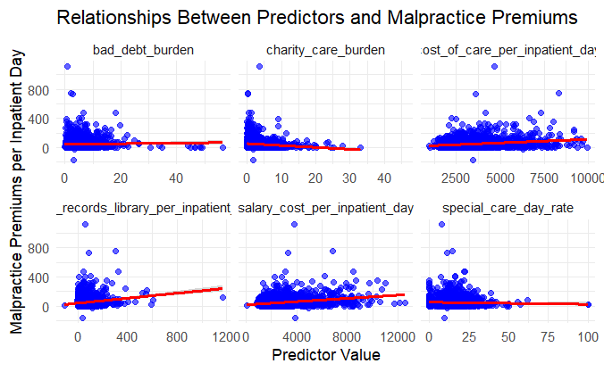
Exploratory Data Analysis – Data Visualization
This scatter plot effectively highlights how these cost related predictor variables influence malpractice premiums and helps identify patterns for further analysis.
Figure 3.2 Correlation Heatmap

Slide 8
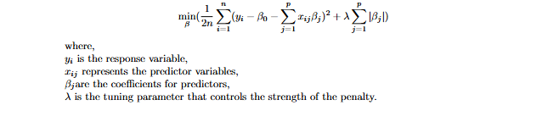
LASSO (Least Absolute Shrinkage and Selection Operator)
LASSO (Least Absolute Shrinkage and Selection Operator) is a regression technique that is particularly useful for variable selection and regularization. It works by adding a penalty term to the ordinary least squares (OLS) loss function. This penalty is proportional to the absolute value of the coefficients:

Slide 9
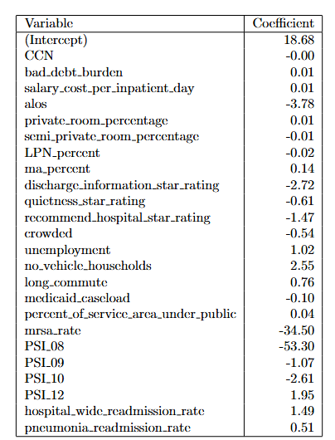
Select Significant variables by Using LASSO
By reducing the dimensionality from 72 to 20 variables, LASSO provides a simpler and interpretable model, which can improve prediction accuracy and focus on critical predictors.

Slide 10
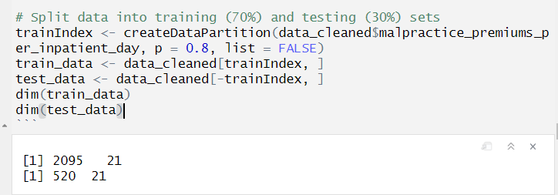
Dataset Preprocessing – Training Data and Testing Data
To train and test our model, we allocate 80% of the data for training and 20% for testing. The training dataset comprises 2095 observations, with the testing dataset containing 520 observations.

Slide 11
Decision Tree
Introduction
A decision tree is a tree-like flowchart that assigns classifications to individual observations. Each branch of the tree separates the data into subsets, in the sense that they are more likely to share the same class label.
Decision trees are powerful tools for identifying feature importance. By constructing a decision tree, we can visually inspect the hierarchy of variables, highlighting which factors are the most influential in determining malpractice premium. Moreover, decision trees can be utilized for predictive purposes. We can use the decision tree to forecast the cost of malpractice premium based on significant cost and non cost related variables.

Slide 12
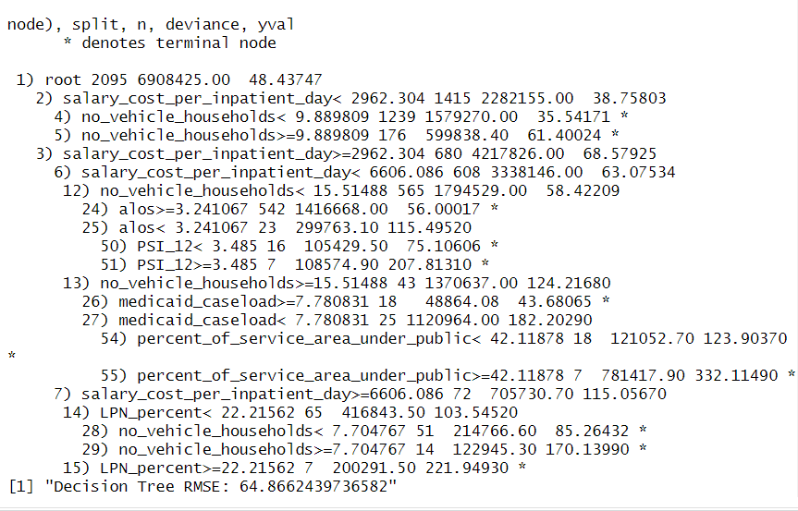
Decision Trees – Fitting Model
The initial split in the tree is based on the values of “salary_cost_per_inpatient_day”
The "root" of the tree describes 2,095 observations with an average response value of 48.44.
Branches (2) and (3) split based on whether “salary_cost_per_inpatient_day” is <2962.304 or ≥2962.304.
Branches (4) and (5) split further based on the values of “no_vehicle_households”
Other splits are based on alos, “PSI_12”, “percent_of_service_area_under_public”, and “LPN_percent”.

Slide 13
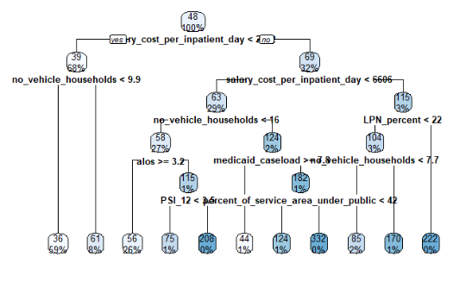
Decision Tree(Visualization)

Slide 14
Random Forests
Introduction
A Random Forest is a natural extension of a decision tree. It is a collection of decision trees aggregated by majority rule, thereby improving predictive accuracy and reducing overfitting.
Random forests will allow us to not only identify the most critical features but also quantify their relative importance in predicting malpractice premium.

Slide 15
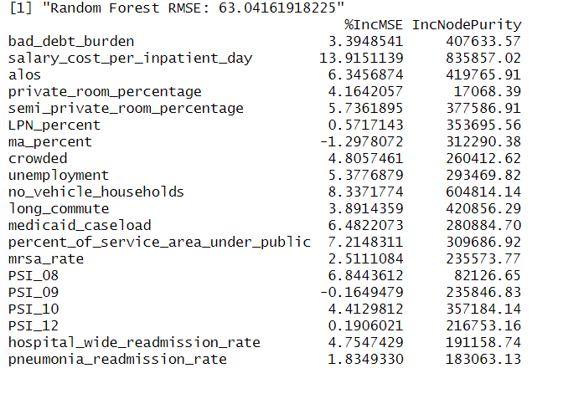
Random Forests – Importance
Using the function ‘importance()’, we can identify the most important predictors. The stronger the predictor, the greater the average decrease in the Gini coefficient resulting from splits using that predictor. In this case, “salary_cost_per_inpatient_day” emerges as the most critical variable, followed by “no_vehicle_households” and “alos”.

Slide 16
Neural Network
Introduction
A more complex, non-linear model that is capable of capturing intricate patterns in the data.
Neural networks are used to explore whether deep learning techniques can outperform traditional machine learning methods to predict malpractice costs.

Slide 17
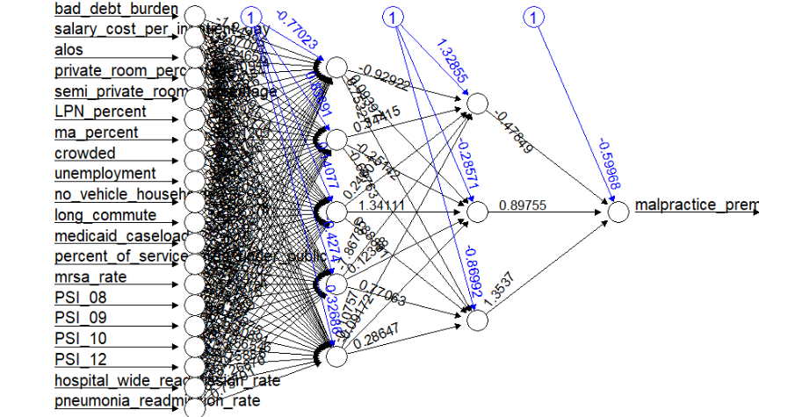
Neural Network(Visualization)

Slide 18
Conclusion – Model Comparison
Decision Tree RMSE: 64.8662439736582
Random Forest RMSE: 63.04161918225
Neural Network RMSE : 71.8815111208419
Best Performing Method**: Random Forests, due to their balance in training and generalization performance.

Slide 19
Conclusion – Key Variables Identified
“Salary_cost_per_inpatient_day” variable is the most significant predictor among all cost related variable and “no_vehicle_households”, and “alos” were also identified as the most significant predictors among non cost variables contributing substantially to the model's accuracy and node purity.
Random Forest strikes the best balance between reliability, interpretability, and computational efficiency, making it the superior choice for identifying key variables compared to Decision Trees and Neural Networks.

Slide 20
Thank you !

